Slide 1
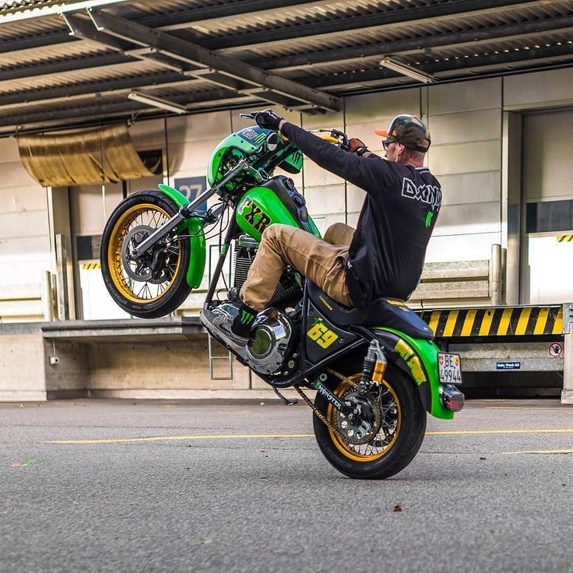
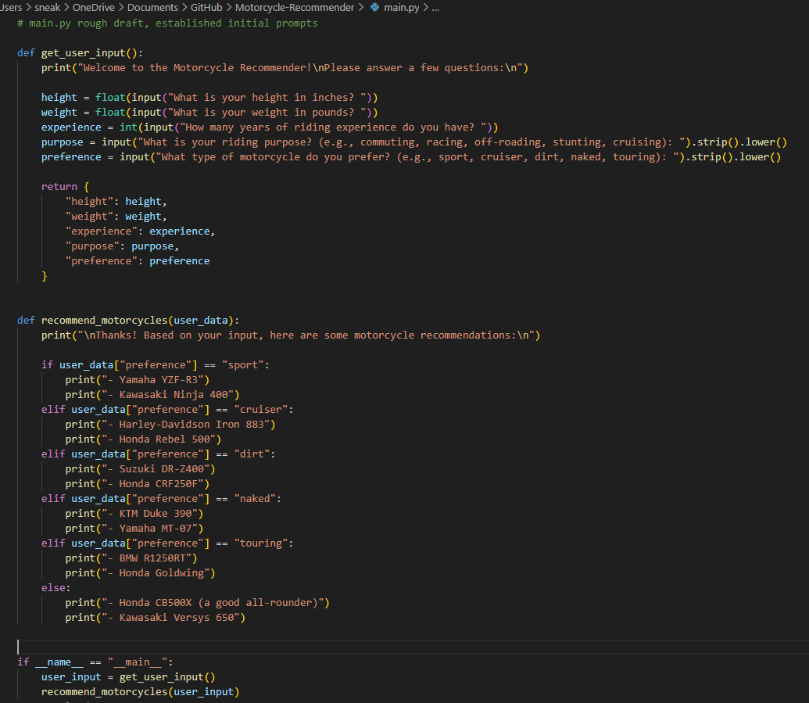
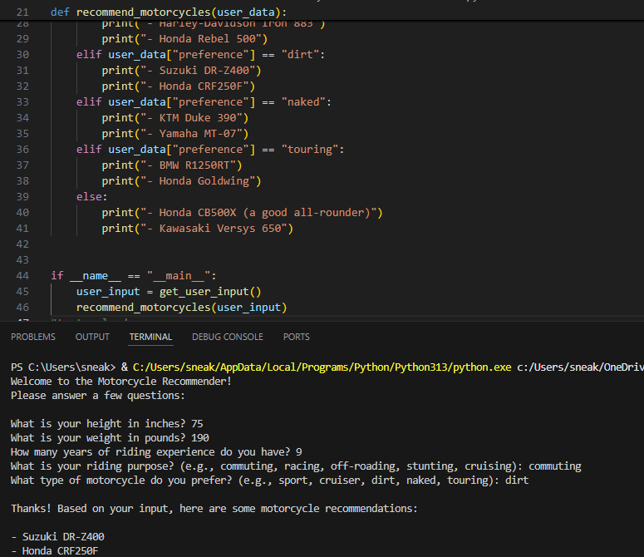
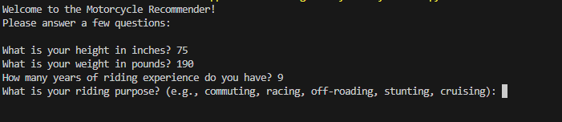
Motorcycle Recommender
By: Ali Siddiqi
This application aims to find the perfect ride for you based on your experience and style. Smart motorcycle shopping starts here!

